Slide 1


“QR GENERATION USING
OBJECT-ORIENTED PROGRAMMING”
DSA - 0110
OBJECT ORIENTED PROGRAMMING WITH C++ FOR APPLICATION DEVELOPMENT
CAPSTONE PROJECT – NOV-2024
Guided by:
DR S Shankar
Presented by:
1.192211920- K Prasanth
2.192224118- Sk Muzamil

Slide 2

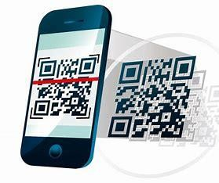
Abstract
This project is about getting into the websites using QR codes by Object oriented Programming with c++. we aim to make the process simple and creative.
Beyond the technical implementation, our study highlights the intersection of coding and design, demonstrating how creative solutions can lead to elegant and functional web applications.
Our project leverages the power of QR codes and C++ to simplify the process of accessing websites. Users can instantly navigate to their desired web applications by scanning a QR code.
Keywords: QR code, QRWebGen, Object oriented Programming , c++.

Slide 3

Introduction
QRWebGen is an innovative object oriented programming with c++ project that introduces a novel approach to web application generation using QR codes.
This project aims to simplify the deployment and access of web applications by leveraging the convenience of QR codes.
With QRWebGen, users can create and share QR codes that, when scanned, instantly generate a web application tailored to their specific needs.
Web applications generated with QRWebGen can be easily updated in real-time. Users can modify the content or features of their web application, and the changes will be instantly reflected when the QR code is scanned.
By scanning a QR code, users can instantly deploy their web application, significantly reducing the time and effort required for traditional web development and deployment processes.

Slide 4

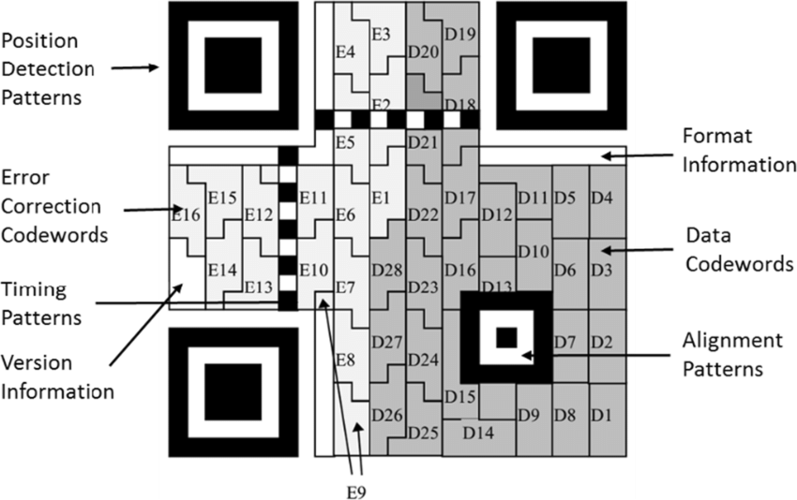
Objectives
Utilize object-oriented programming (OOP) principles to design a modular and scalable architecture for the QR code-based web generation system.
Ensures that web applications generated via QR codes are compatible with various devices and web browsers, providing a consistent user experience across different platforms.
Provides a user-friendly interface that allows individuals with minimal technical knowledge to create, customize, and deploy web applications and also allow users to update their web applications in real-time, with changes reflected instantly upon scanning the QR code.

Slide 5

LITERATURE REVIEW
Innovative Approach to Web Application Deployment:
QR (Quick Response) codes have gained widespread adoption due to their ability to store information in a compact, machine-readable format. Initially developed by Denso Wave in 1994, QR codes were primarily used in the automotive industry to track parts during manufacturing. Over time, their application expanded to marketing, payments, and data sharing due to their high storage capacity and ease of scanning. A QR code typically consists of black and white modules arranged in a square grid, which can be decoded by a smartphone or QR scanner.
WEB GENERATION OF QR CODE USING OBJECT ORIENTED PROGRAMMING AUTHOR: ZHENJI, WHANG LI, J., & MENJHILO, J YEAR: 2019 2.1
OVERVIEW Algorithm development plays a pivotal role in this study, as it involves implementing complex mathematical algorithms Within C++ to generate QR codes accurately.

Slide 6

METHODOLOGY
Components:
QR Code Generator: Creates encoded QR codes.
Web Application Generator: Dynamically generates web apps based on QR code data.
Database: Stores user preferences, templates, and content.
Security Module: Ensures secure data transmission and encryption.
Object-Oriented Design:
Classes: QRCode, WebApp, UserProfile, Security.
Inheritance and Polymorphism: Extend base classes and handle various content types.
Workflow:
Encode data into QR codes.
Scan and decode QR codes.
Generate customized web apps.
Users Interact with generated apps.
Security:
Encrypt QR code data.
uses secure protocols for data transfer.

Slide 7

Design For Proposed System
User Interface:
Admin Interface:
Manages templates
QR code generation.
User Interface:
Scans QR codes
interacts with web apps.
Scalability:
Modular, extensible design for future enhancements.

Slide 8

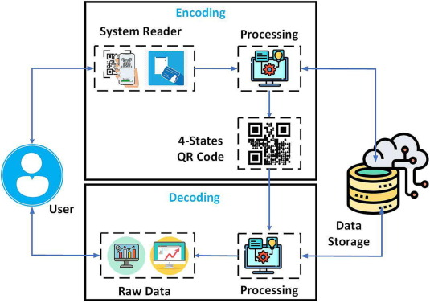
Architecture Diagram

Slide 9

PROGRAM
#include <iostream>
#include "qrcodegen/QrCode.hpp"
qrcodegen::QrCode; // Namespace alias for QrCode class
class QRCodeGenerator { public:
QRCodeGenerator(const std::string& text) : text(text) {}
void generateQRCode() {
const QrCode::Ecc errorCorrection = QrCode::Ecc::LOW; // Error correction level QrCode qr = QrCode::encodeText(text.c_str(), errorCorrection); // Generate QR
code
// Output the QR code as ASCII art to the console
std::cout << qr.toSvgString(4) << std::endl;
}
private:
std::string text;
};
int main() {
std::string inputText = "https://example.com"; // Text or URL to encode in QR code
QRCodeGenerator generator(inputText); // Create an instance of QRCodeGenerator generator.generateQRCode(); // Generate and display the QR code
return 0;
}

Slide 10

Conclusion
QR codes offer a convenient and efficient method for generating website links.
Their simplicity and ease of use make them an excellent tool for connecting physical and digital realms, enhancing user experience, and streamlining access to online content.
As technology continues to advance, QR codes are likely to play an increasingly integral role in bridging the gap between the physical and digital worlds.
As technology evolves, potential advancements in customization, dynamic updates, security, and integration with emerging technologies hold promise for even more robust and engaging QR code experiences.
Embracing QR codes for website links remains a forward-looking strategy, offering a streamlined and efficient means for users to access online content effortlessly.

Slide 11

References
" Tjahyadi, Surya. "Development of QR code-based data sharing web application using system development life cycle method." Journal of Information System and Technology (JOINT) 2.2 (2021): 64-73.
“Lee, Keun-Wang. "A study of Content Generation System using QR Code in Smart Phone Environment." Journal of the Korea Academia-Industrial cooperation Society 14, no. 6 (2013): 2999-3004.
" Venkatachalam, G., et al. "QR code generation for mall shopping guide system with security." Asian Journal of Applied Science and Technology (AJAST) 1.4 (2017): 37-39.. 8 Tekawade, N., Kshirsagar, S., Sukate, S., Raut, L. and Vairagar, S., 2018, August.
Haque MS, Dybowski R. Advanced QR code-based identity card: a new era for generating student id card in developing countries. In IEEE First International Conference on Systems Informatics, Modelling and Simulation.

Slide 12






